Slide 1


Slide 2



The plural form of most nouns is created by adding the letter s
girl
s
girl

Slide 3
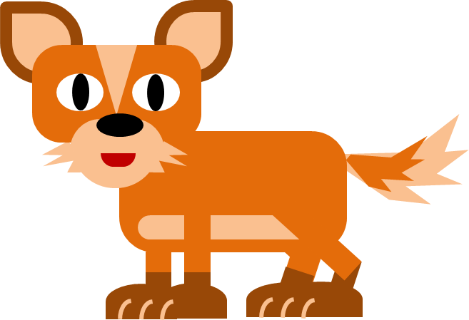
Nouns that end in -ch, -sh, -x, -s or -z add -es for the plural
fox
fox
es

Slide 4

Nouns that end in -ch, -sh, -x, -s or -z add -es for the plural
witch
witch
es

Slide 5

Nouns ending in a consonant plus -y, make the plural by changing -y to -ies:
cherry
cherr
y
ies

Slide 7

man
men

Slide 8

woman
women

Slide 9




child
children

Slide 10





person
people

Slide 11


tooth
teeth

Slide 12

foot
feet

Slide 13

mouse
mice

Slide 14

Ends with –fe | Change f to v then Add –s
knife
kni
ves
fe

Slide 15

Ends with -f | Change f to v then Add -es
wolf
wol
ves
f

Slide 16

Ends with -o | Add -es
tomato
tomato
es

Slide 17

Some nouns are the same in both singular and plural form
sheep
sheep

Slide 18

Some nouns are the same in both singular and plural form
fish
fish

Slide 19

Some nouns are the same in both singular and plural form
deer
deer

Slide 20


What’s the plural form of …
boyes
boy
boys
boies

Slide 21
What’s the plural form of …
watchs
watch
watchies
watches

Slide 22
What’s the plural form of …
wives
wife
wifs
wifes

Slide 23
What’s the plural form of …
halfs
half
halves
halfes

Slide 24
What’s the plural form of …
tooths
tooth
teeth
toothes

Slide 25
What’s the plural form of …
lives
life
lifes
lifs

Slide 26
What’s the plural form of …
leafes
leaf
leafs
leaves

Slide 27
What’s the plural form of …
foots
foot
feet
footes

Slide 28
What’s the plural form of …
strawberrys
strawberry
strawberryes
strawberries

Slide 29
What’s the plural form of …
womans
woman
women
womanes

Slide 30


